Slide 1
SRP Thermal Mass
Courtney Hiatt, Aaron Espinoza, Janelle Peña, Steven Galloway, Maciej Ziomber
Notes:
Janelle
Hook for the audience
Population size
Storytelling vs telling a story
Call on someone I know. Ask them the question… What is one resource every single person and living creature needs to survive? Ans… Water. What is something that almost everyone uses every single day?.... Electricity…. Both water and electricity are a We need both to live in these modern days. Our team has created a system that allows us to do both. We have designed a hydro power plant using waste water from old uranium mines to generate and provide electricity to those without power. The team that has accomplished this goal is myself Janelle Peña…..

Slide 2
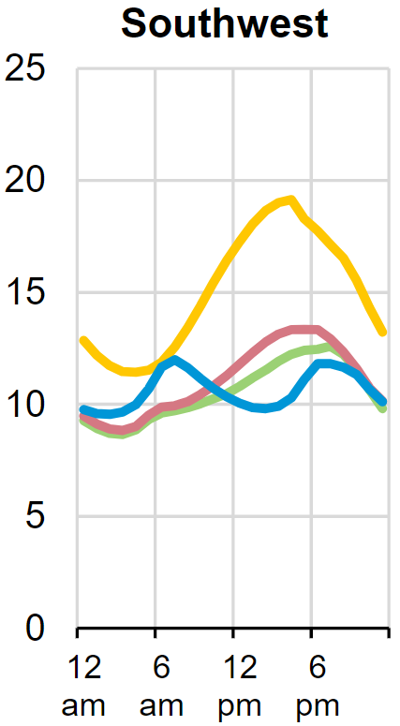
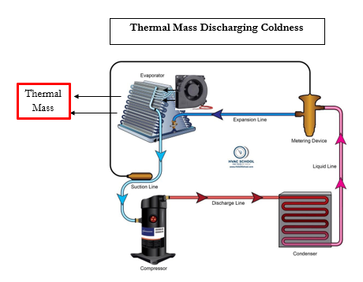
Project Description
2
Fig. 1 Average hourly electricity load by region [20]
The peak of the demand has the highest cost
Using more energy storage in the minimum demand times and releasing that energy during the peak demand is our goal
Sponsored by Salt River Project (SRP)
Important because it will become vital for renewable energy to be reliable and viable
Individual home level
[20] Hourly electricity consumption varies throughout the day and across seasons - U.S. Energy Information Administration (EIA), https://www.eia.gov/todayinenergy/detail.php?id=42915 (accessed Feb. 5, 2024).
Notes:
The overall pic, heat goes in heat goes out

Slide 3
FMEA
3
Failure Mode and Effects Analysis
Failure modes are listed and imagined for all possible failures. Here, the mode of highest risk is ice expansion in the casing. Pex A is designed to expand at the same rate as the water. The freezing effect will risk the copper line being crushed.

Slide 4
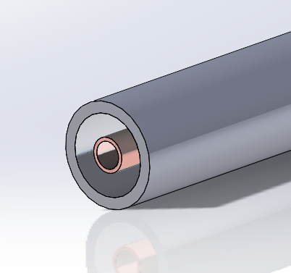
Problem Definition
4
Context:
The heat transfer fluid pipe failure will effectively end the function of a thermal mass storage device.
The thermal mass surrounds the pipe containing the heat transfer fluid.
The thermal mass is water that freezes, increasing its volume by up to 7%
The container for the thermal mass flexes to mitigate stress.
Notes:
Show big than focus on detail, Rough dimensions, we are buying off the shelf of a,b,c,et Talk about pump calcs, They should know about every
There are general HVAC and components, wiring diagram, rated of inputs,
Pump flow rate,

Slide 5
Problem Definition
5
Why the Finite Element Method?
A G. Lamé equation will produce an exact hoop and radial stress solution. It will also solve for displacement.
Water does not freeze consistently, and the unpredictability of solidifying will induce point loads.
Point loads will require a numerical approximation to obtain any level of accuracy.
This data will inform our decisions on what materials we can use, the wall thickness, and a future fatigue model to find a factor of safety (FoS).
Notes:
Show the big picture items first (Gen pic) Show rough scale rough dimensions, materials, What does each component do, more detail
Label the different components and simple dimensions
Anything with flowcharts and the cycles
A controller portion

Slide 6
Analysis Model
6
Geometry
Tubes for heat transfer come in consistent copper tubes that have a higher thermal conductivity. Aluminum is less expensive and still a viable option.
The tube geometry is based on the need for a predictable flow with the possibility of turbulence-inducing devices. The size of the container pipe cannot be found in larger diameters.
The outer wall of the tube is .375 in (9.525 mm), and the inner diameter is 0.315 in (8.001 mm) [1]

Slide 7
Analysis Model
7
Mesh
To create an efficient element size requires analysis of a few factors.
Total pressure model needed for validation of the G. Lamé equation
Ansys determines the smallest size because the license will not allow a mesh fine. (found with an experiment in Ansys)
Symmetry will allow us to refine to a smaller number of elements.
Symmetry should allow more simplistic 2D point load calculations with consistent element types.
Notes:
Inputs outputs, material, charging, each arrow needs to state energy, user vs mechanical, flow, How does this inform a design, both

Slide 8
Analysis Model
8
Loads
Water changes volume by 7%, and it is inconsistent. It is possible, but unlikely, that the volume change could be normal to the surface of the tube.
Solving for the displacement of a 7% reduction of the tube will inform the loads that will develop against the surface of the pipe.
$$\frac{\left(Pipe diameter^{2}∗\frac{π}{4}∗0.07\right)}{2}=0.003865 in (0.0762 mm)$$
A range of failure values should also be tested in the point loads section where Ansys will be invaluable.
Annealed ¼ in Copper tube working pressure is 913 kPa (6295 psi)
Notes:
Inputs outputs, material, charging, each arrow needs to state energy, user vs mechanical, flow, How does this inform a design, both

Slide 9
Analysis Model
9
Materials
[2] Annealed ¼ in Copper tube
[2] Working pressure is 913 kPa (6295 psi)
[3] Annealed copper
Modulus of Elasticity (110 GPa , 16000ksi)
Poisson's Ration (0.343)
Shear Modulus (46.0 Gpa , 6670 ksi)
Yielding Strength (40-80 GPa , 5.8-11.6*10^6 (psi))
Notes:
Inputs outputs, material, charging, each arrow needs to state energy, user vs mechanical, flow, How does this inform a design, both

Slide 10
Analysis Model
10
Materials
[2] Annealed ¼ in Copper tube
[2] Working pressure is 913 kPa (6295 psi)
[3] Annealed copper
Modulus of Elasticity (110 GPa , 16000ksi)
Poisson's Ration (0.343)
Shear Modulus (46.0 Gpa , 6670 ksi)
Yielding Strength (40-80 GPa , 5.8-11.6*10^6 (psi))
Notes:
Inputs outputs, material, charging, each arrow needs to state energy, user vs mechanical, flow, How does this inform a design, both

Slide 11
Analysis Model
11
Materials
[2] Annealed ¼ in Copper tube
[2] Working pressure is 913 kPa (6295 psi)
[3] Annealed copper
Modulus of Elasticity (110 GPa , 16000ksi)
Poisson's Ration (0.343)
Shear Modulus (46.0 Gpa , 6670 ksi)
Yielding Strength (40-80 GPa , 5.8-11.6*10^6 (psi))
Notes:
Inputs outputs, material, charging, each arrow needs to state energy, user vs mechanical, flow, How does this inform a design, both

Slide 12
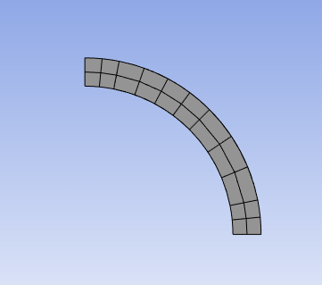
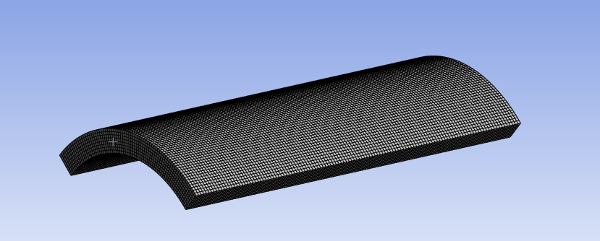
12
Analysis Model
Boundary Conditions
There is a free boundary condition on the inside of the pipe
There is a pressure boundary on the outside of the pipe
For verification, we will use the working condition of 913 kPa
- Purple Curve: Free Boundary
Red Arrows: Normal Force
Black: Roller Support
Notes:
Inputs outputs, material, charging, each arrow needs to state energy, user vs mechanical, flow, How does this inform a design, both

Slide 13
13
Notes:
Inputs outputs, material, charging, each arrow needs to state energy, user vs mechanical, flow, How does this inform a design, both

Slide 14
14
Notes:
Inputs outputs, material, charging, each arrow needs to state energy, user vs mechanical, flow, How does this inform a design, both

Slide 15
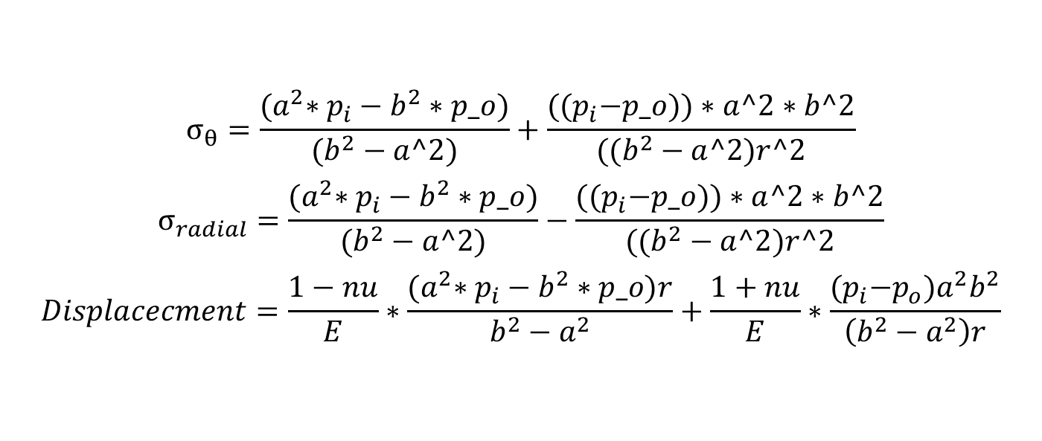
15
Notes:
Inputs outputs, material, charging, each arrow needs to state energy, user vs mechanical, flow, How does this inform a design, both

Slide 16
Verify
17
MatLab for a function
Radial stress = 2.1882e+06 Pa
Tangential Stress = -2.1882e+06 Pa
Displacement = 1.2724e-04 m

Slide 17
Where it is already used
17
Other companies use thermal masses like these with stainless steel fin configurations
The ANSYS analysis can be used to verify crucial information that we need for this project
Future Work Continuous applications and analysis for capstone and the thermal mass storage unit

Slide 18
18

Slide 19
Thank you!
Notes:
Janelle Conclusion
Like so many projects before, the end is just the beginning. This hydro-plant has the ability to change the lives of people on the navajo reservation. When this project is completed, our project might be done but their opportunities have just begun. Thank you for your time we hope you have enjoyed our presentation.

Slide 20
References
[1] https://www.petersenproducts.com/pipe-specs/copper-tubing-sizes
[2] https://www.engineeringtoolbox.com/copper-tubes-dimensions-pressure-d_84.html
[3] https://www.matweb.com/search/datasheet_print.aspx?matguid=9aebe83845c04c1db5126fada6f76f7e
[4] Advanced Strength and applied Elasticity 4th edition, Ugural and Fenster, 2003 Pearson Education

